Slide 1
SQL Day Lite 2026 · Gdańsk
Slim Models, Lower Bills
Cutting Power BI and Fabric capacity costs from the inside
Two real projects, dozens of models and one very big fact table
Dominik Szcześniak / Senior BI Developer / Dane Są Wszędzie

Slide 2




PARTNERS & SPONSORS
ORGANIZERS
GOLD SPONSORS
PATRONS

Slide 3


Intro
About me
In the data industry for about 9 years.
Mostly on the Microsoft stack, both on-prem and in the cloud
Current project: Databricks + Power BI as the semantic layer
Industries: logistics, banking, finance, FMCG, sports (football), HR
Scan to check out my podcast
Podcast 🎙️ : Dane Są Wszędzie available on Spotify, YouTube, Apple Podcasts
Blog 📊✍️ 🧩💡 : danesawszedzie.pl
IG @danesawszedzie
Mail: kontakt@danesawszedzie.pl

Slide 4
Agenda
01
Semantic models as a serving layer
02
Where the memory goes (demo)
03
Case 1: a 120 GB model
04
Case 2: a mandated cost cut
05
Takeaways and Q&A

Slide 5
Big Picture
Reports
Excel pivot tables
LLMs and AI tools
Databricks
Gold layer
Semantic models
The bigger company, the more data -> bigger semantic models.
And a bigger capacity bill.

Slide 6
One model per domain.
Please don’t build one model for everything.
One model for everything
One model per domain
All facts, all history, all users
Finance
Sales
Supply chain
Risk
One refresh, one memory peak, for everything
Own schedule, smaller peaks, a clear owner

Slide 7
SSAS, AAS or Power BI: same VertiPaq engine, same tricks
SQL Server Analysis Services
Azure Analysis Services
Power BI semantic models
on-premises
priced per server tier
priced per capacity
Same engine, same tools: DAX Studio, VertiPaq Analyzer and Tabular Editor 2/ 3 work against all three.

Slide 8
Nobody optimizes models for fun.
It’s either a migration or a cost cut.
Migration
Mandated cost cut
Moving from SSAS or AAS to Fabric. Every model gets looked at, and priced.
Someone finds out it costs too much. Not only after the first cloud bill.
Case 1 started here
Case 2 started here

Slide 9
The bill came down to one thing: model size
Memory limit per model
Size
One model has to fit under the SKU’s memory limit
Refresh
decides the capacity SKU you have to reserve
A full refresh holds the old and new copy at once
Refresh windows
Bigger models refresh longer and hit timeouts

Slide 10
Demo: where does the memory actually go?
1
DAX Studio → View Metrics
VertiPaq Analyzer: size and cardinality per column
2
Sort by size
Hash keys, duplicated values, long unique text
3
Fix it in Tabular Editor
Remove columns, set properties, deploy
What I check first: % of table size, cardinality vs. row count, dictionary size, hierarchy size

Slide 11
A 120 GB model
Case study 1
Talk to the business first, then tune the engine

Slide 12
Where we started:
120 GB, billions of rows, 15 years of history
120 GB
Billions
15 years
Full detail
model size in memory
of rows in one fact table
of history kept in the model
every observation, no aggregates
“We need all of it.”
I hear that sentence on almost every project. It’s worth checking.

Slide 13
First question: do you really need all the data?
Grain
What I usually go with
Do you need every row, or would a daily or monthly aggregate answer the question?
Current year plus two years back at row level. Older data stays in the lakehouse, or comes in aggregated.
History
How many years do you really open at row level?
Audience
Which roles see which rows, and what does each role actually filter on?

Slide 14
The funny one: business roles only saw IsCurrent = 1
Fact table rows
IsCurrent = 1 · ~70%
IsCurrent = 0 · ~30%
Business roles (Entra groups)
Admin roles only
Row filter on the fact table:
Only admins could query these rows. We still loaded them every day.
'Fact'[IsCurrent] = 1
One question, “who actually needs IsCurrent = 0?”, and the data was cut.

Slide 15
Legacy hash keys: one distinct value per row, and a huge dictionary
Before: string hash keys
After: integer surrogate keys
9f2c4e1a7d0b3c55e8a1
1048571
04be77d1c9a2f6e0b3d4
1048572
c3a8e5f1027bd94e6a11
1048573
…one distinct value per row
…compact integers
Nearly one distinct value per row, so the dictionary is as big as the data.
Integers compress well. We generate them once, during the load in Databricks.

Slide 16
The same value, stored twice: once as a decimal, once as text
Answers fact table (example rows)
Key | Value | ValueText
1048571 | 0.12355434364564 | "0.12"
1048572 | 2.50032545446780 | "2.50"
1048573 | 17.8342454465671 | "17.83"
1051235 |  | Institution A
What we agreed
Keep Value (4 decimals), remove „numbers” from Value Text.

Slide 17
Why the standard incremental refresh didn’t work for us
Incremental refresh policy from Power BI Desktop
Archive: loaded once, never refreshed
Rolling refresh window
Historical periods that changed in the source
The window rolls by date, not by change
The only safe option was a full reload
Full reloads stressed the capacity and the model often hit the timeouts

Slide 18
So we built our own: year-month buckets, refreshed only when they change
1
2
3
4
5
GitLab pipeline
Count rows
Materialize
Compare
Refresh API
triggers the batch reload
per year-month bucket
the counts as a snapshot
with the last snapshot
only for the changed partitions
SELECT bucket_partition, -- e.g. 202503
COUNT(*) AS row_count
FROM gold.fact
GROUP BY bucket_partition;
Some days only two partitions changed. We refreshed those two, not 15 years.

Slide 19
Refresh through the REST API, with parallelism Databricks can handle
Enhanced refresh API, request body
List only the changed partitions
The body carries the output of the snapshot comparison
POST …/datasets/{id}/refreshes
{
"type": "full",
"commitMode": "transactional",
"maxParallelism": 8,
"objects": [
{"table":"Fact","partition":"202503"},
{"table":"Fact","partition":"202411"}
]
}
Cap it with maxParallelism
For example 16 queries in flight across 8 partitions
Load-test the source first
The Databricks SQL warehouse has to take the load
Together with delta table partitioning on the Databricks side: refresh time cut in half

Slide 20
IsAvailableInMDX: free memory, as long as Excel doesn’t need the column
VertiPaq builds a hierarchy for every column so Excel can query it with MDX. Hidden technical columns don't need one.
Set to false
Keep true
Hidden surrogate and hash keys
Columns used only in relationships
Technical flags not exposed to users
Visible columns Excel users pivot on
Columns used in user hierarchies
In TMDL
column AnswerKey
dataType: int64
isHidden
isAvailableInMdx: false
Or in Tabular Editor: select the columns, set Available In MDX to False.
Get it wrong and Excel hierarchies break.

Slide 21
120 GB down to ~64 GB, and next year’s reserved capacity cost half
Semantic model size in memory
What did it
Business challenge
Dropped IsCurrent = 0 rows nobody could see
−47%
Model hygiene
Integer keys instead of hashes, one value column
Engine settings
IsAvailableInMDX off on hidden columns
Refresh design
Custom partitions refreshed only on change

Slide 22
A mandated cost cut
Case study 2
Dozens of models, one deadline: measure size and usage, retire what nobody queries

Slide 23
New director, new rule: cut the costs by a fixed date
FMCG enterprise
Many teams, many environments, many models on each
Mixed estate
Power BI models on Fabric capacities, AAS models on their own servers
Post-migration bills
The first cloud invoices came in above what was planned
“We use all of it”
Every owner said their model was needed

Slide 24
Two questions for every model: what’s in it, and who uses it?
Size
What is inside
Combined
DAX Studio and VertiPaq Analyzer metadata: size per model, table and partition
One dataset: every model and partition with its size, its capacity or server, and its query history.
Usage
Who queries it
Decision per model:
keep, trim or retire
Azure Log Analytics: every query, by model, user and time

Slide 25

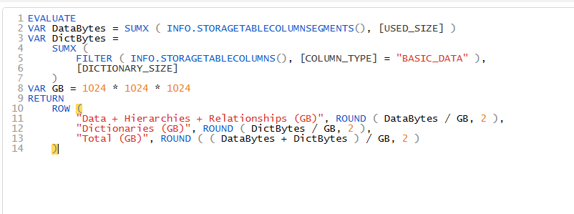
Leverage metadata to get the model size
DMV Approach
DAX Info() Functions

Slide 26
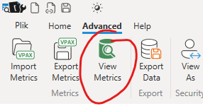
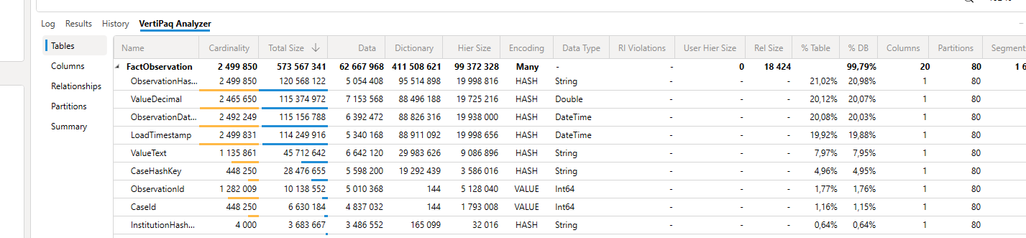
Leverage metadata
DAX Studio

Slide 27
Before deleting anything, we priced each cut from partition sizes
Fact table partitions by region and year (example)
2019
2020
2021
2022
2023
2024
2025
2026
Africa
Europe
Asia
Dropped: older than two years back
Kept: 2024–2026
The maths
Saving ≈ table size × (rows in dropped partitions ÷ total rows)
A 10 GB table with half its rows in old partitions frees about 5 GB.

Slide 28
Log Analytics: the answer to
“but we use it every day”
Turn it on per workspace or server
Usage per model, last 90 days (KQL)
Power BI workspace setting; diagnostic settings for AAS
PowerBIDatasetsWorkspace
| where TimeGenerated > ago(90d)
| where OperationName == "QueryEnd"
| summarize
Queries = count(),
Users = dcount(ExecutingUser),
LastQuery = max(TimeGenerated)
by PowerBIWorkspaceName,
ArtifactName
| order by Queries asc
Basically „SQL Profiler, in the cloud”
Query and refresh events, kept for the retention you set
Query it with KQL
Import into Power BI or land it in a storage account
Budget for it
Ingestion and retention cost money. Bonus: chargeback by team.

Slide 29

DEMO

Slide 30
Big models nobody used went first
Big, barely used
Big, heavily used
Retire first. Example: a large AAS model on test, queried by one person.
Optimize: shorter history, leaner columns, right-sized capacity.
Model size →
Small, barely used
Small, heavily used
Retire or merge when convenient.
Leave alone.
Usage (Log Analytics) →

Slide 31
Then the brutal part: partitions nobody touched in 3–6 months were dropped
What the business said
What the logs said
“We use this data a lot.”
Zero queries
Every model owner, for every partition
on older partitions over the last three to six months
The director’s call: drop them. Harsh, but hard to argue with the logs.

Slide 32
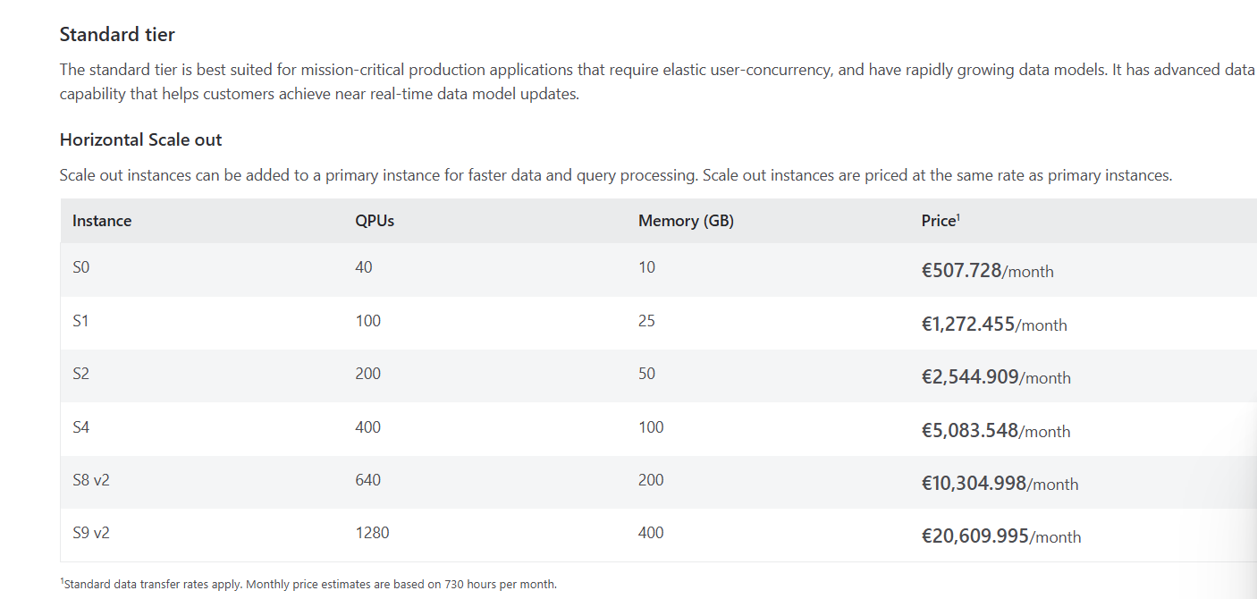
How much did we save?
https://azure.microsoft.com/en-us/pricing/details/analysis-services/

Slide 33
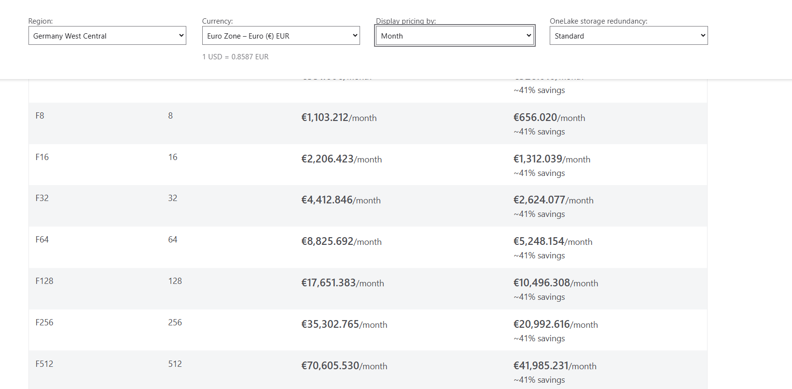
How much did we save?
https://azure.microsoft.com/en-us/pricing/details/microsoft-fabric/

Slide 34
What to try on Monday
Challenge the business
Tune the model
Measure, then cut
Ask about grain, history and audience
Replace hash keys with integer surrogate keys
Price every cut with VertiPaq Analyzer first
Check RLS filters for rows no business role can see
Drop columns that duplicate each other
Log every query with Log Analytics
Keep row-level detail to the current year and two back
Set IsAvailableInMDX = false on hidden technical columns
Retire big models and partitions nobody queries
Use custom partitions when history changes

Slide 35
Inspirations:
Treat what you learnt as framework
Wrap up the things and leverage AI
Fabric – try out SemPy and create a notebook

Slide 36




Dominik Szcześniak
Let’s stay in touch!
Podcast: Dane Są Wszędzie

